Slide 1
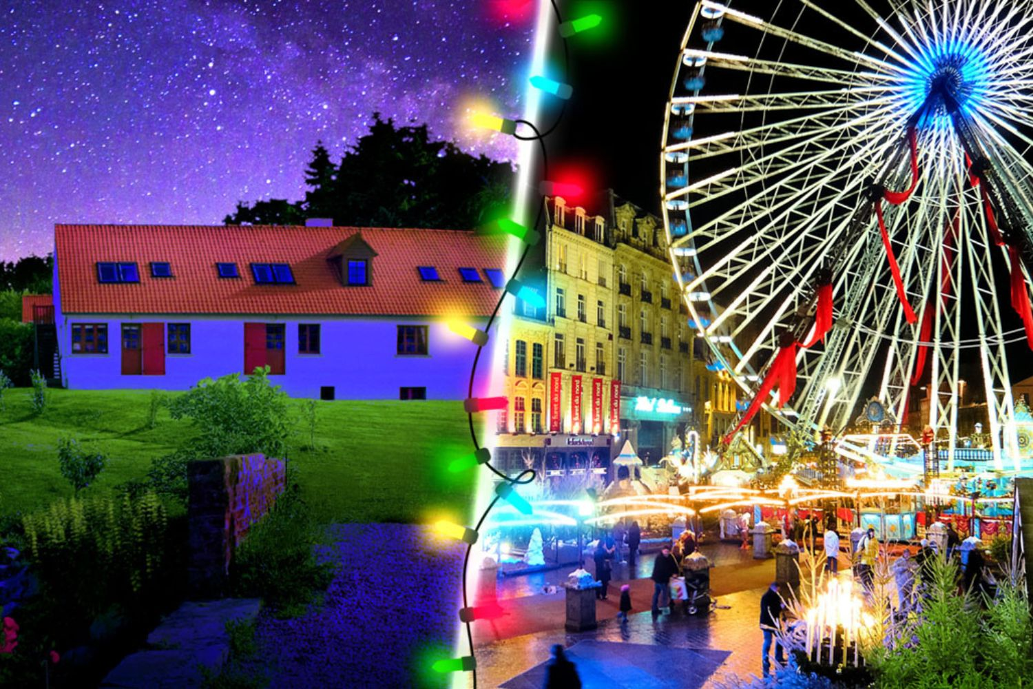
Your trip to
the Opal Coast of France
Christmas & Wintersports Festival
School Name: Date:

Slide 2
You’re in
safe hands
Your child’s safety is our priority and
we ensure the highest standards are met.
ABTA member
ATOL and ABTOT financial protected
School Travel Forum (STF) member
Learning Outside the Classroom (LOtC) Quality Badge holder
AAIAC Adventuremark holder
Audited safety management system
All accommodation audited
More about accreditation.

Slide 3
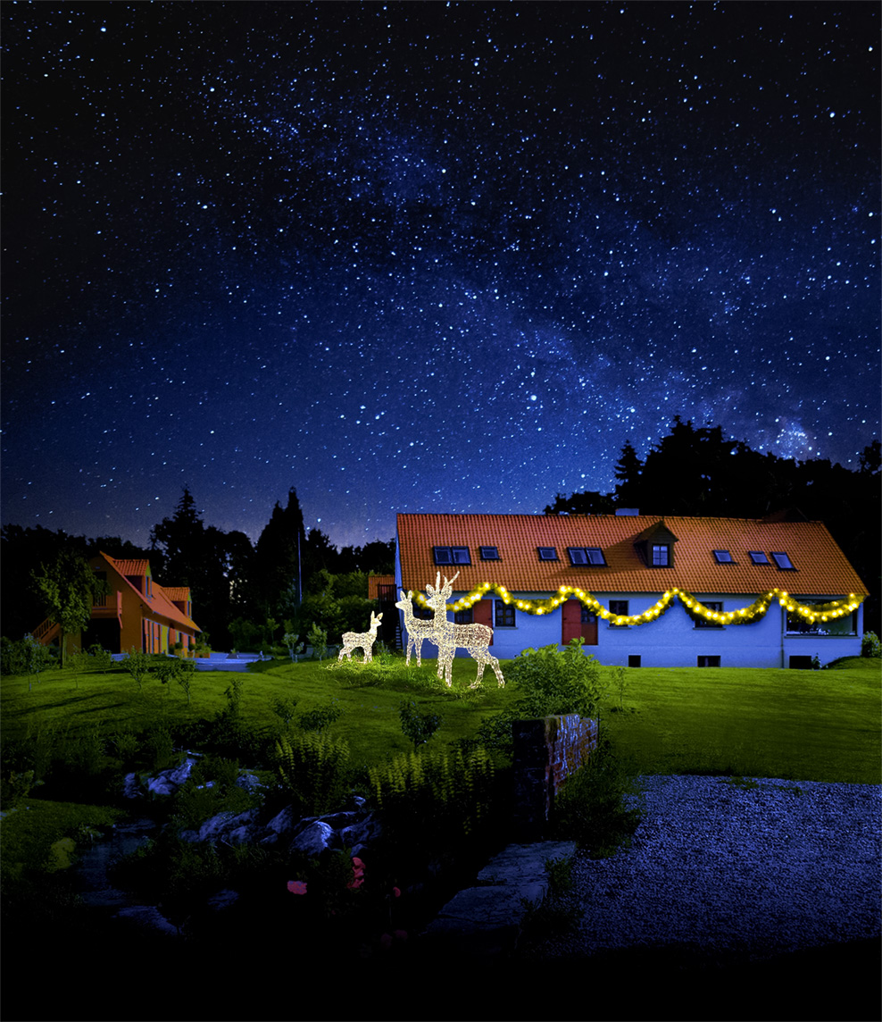
Welcome to the Moulin Centre
Check in to the Moulin aux Draps school centre where you will meet your instructor and get settled.
This centre is set in 22 acres of peaceful green fields with plenty of space to wander safely. During term time, it is exclusively for the use of school groups meaning there are few other distractions for students.

Slide 4
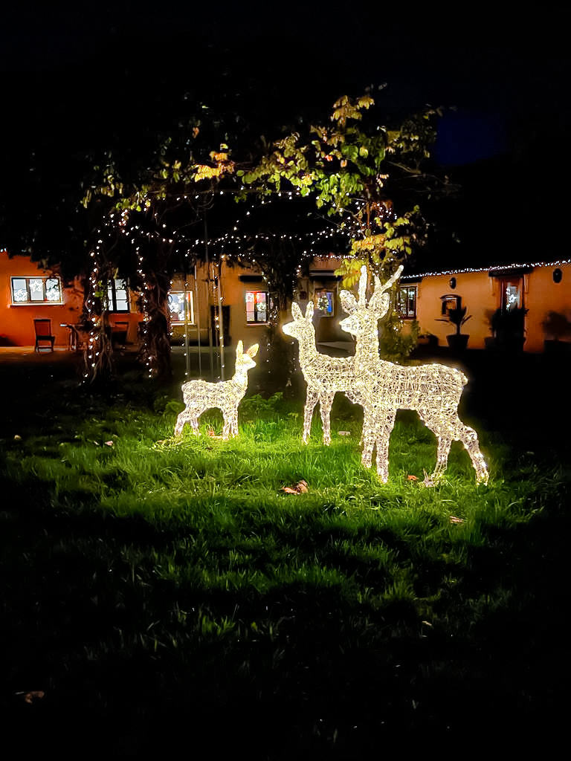
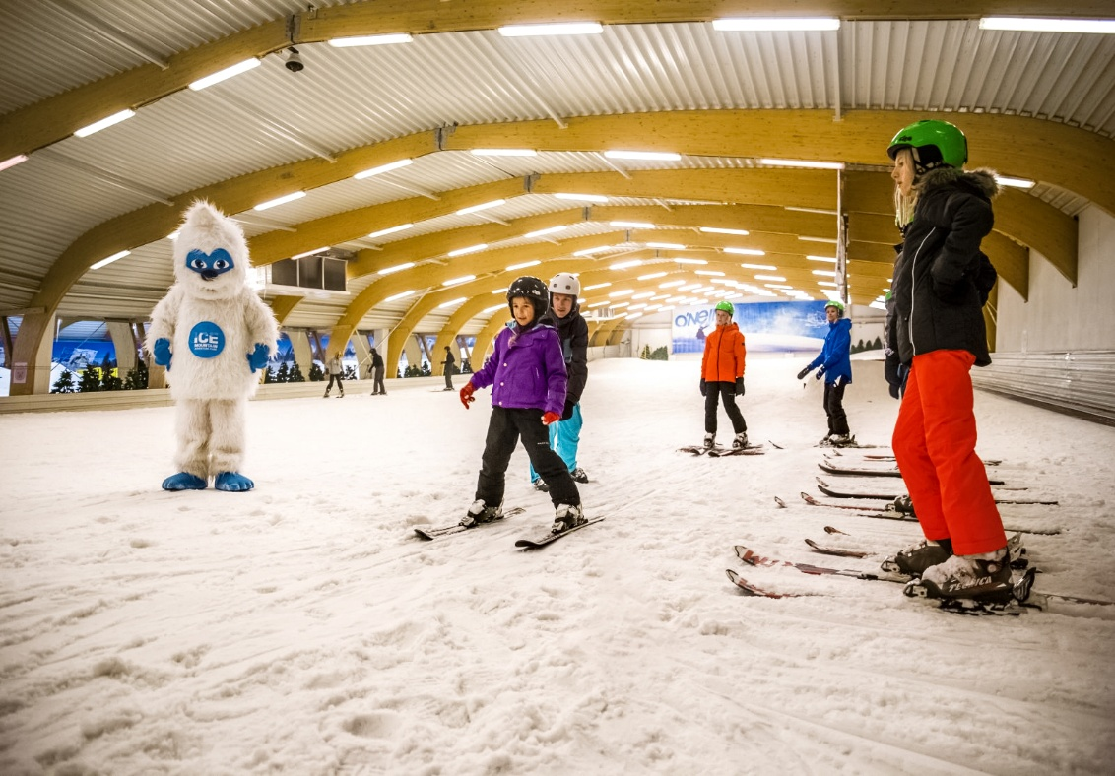
Christmas Wonderland
Enter our Christmas Wonderland and stay in our Voyager Residential Centre, just one hour away from Calais.
Meet your instructor who will lead students through a jam-packed itinerary of activities and games, including real snow skiing.

Slide 5
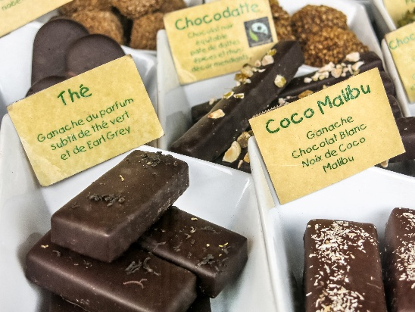
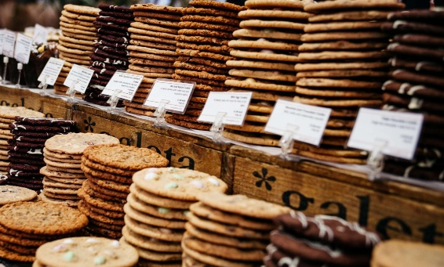
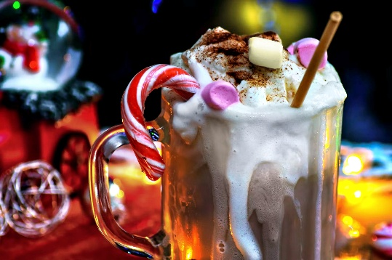
What’s included in your trip
Mouth-watering tour of a French chocolaterie
Winter Wonderland at our Moulin aux Draps residential Centre
Christmas dinner with crackers
Christmas evening activities with your instructor
2-Hour ski lesson on real snow slopes at Ice Mountain in Belgium
Explore the wonders of Lille Christmas Market
Biscuiterie tour & shortbread tasting
Hypermarket stop to grab French goodies & souvenirs
Travel home and arrive back at school, full of Christmas spirit
A great way for your new year group to bond and provide a confidence-boosting school trip.

Slide 6
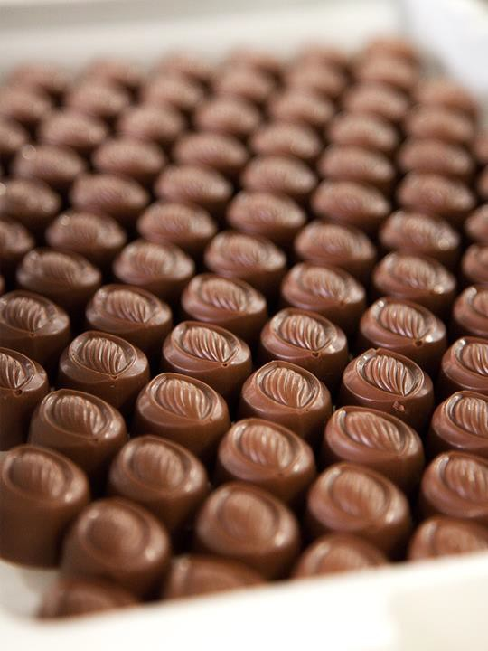
Chocolate factory
Take a trip to a local chocolate factory to see how the world’s most popular food is made.
You will have a guided tour of the workshop, and see the process of melting, moulding and coating, you will even be offered the chance to taste some for yourself
Boulogne Town Trail
Your animateur organises this activity with our tailor made Town Trail requiring the students to read, understand and speak French

Slide 7
Ski lesson
Experience the thrill of skiing on real snow at Ice Mountain in Belgium!
Enjoy a two-hour ski lesson led by expert instructors, perfect for all skill levels. Put your new skills to the test as you enjoy the slopes in a fun and supportive environment.
Boulogne Town Trail
Your animateur organises this activity with our tailor made Town Trail requiring the students to read, understand and speak French

Slide 8
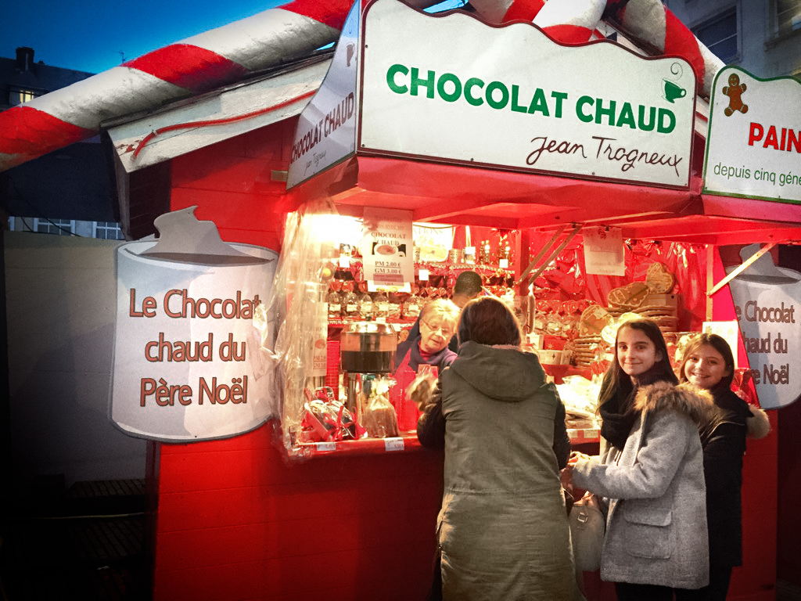
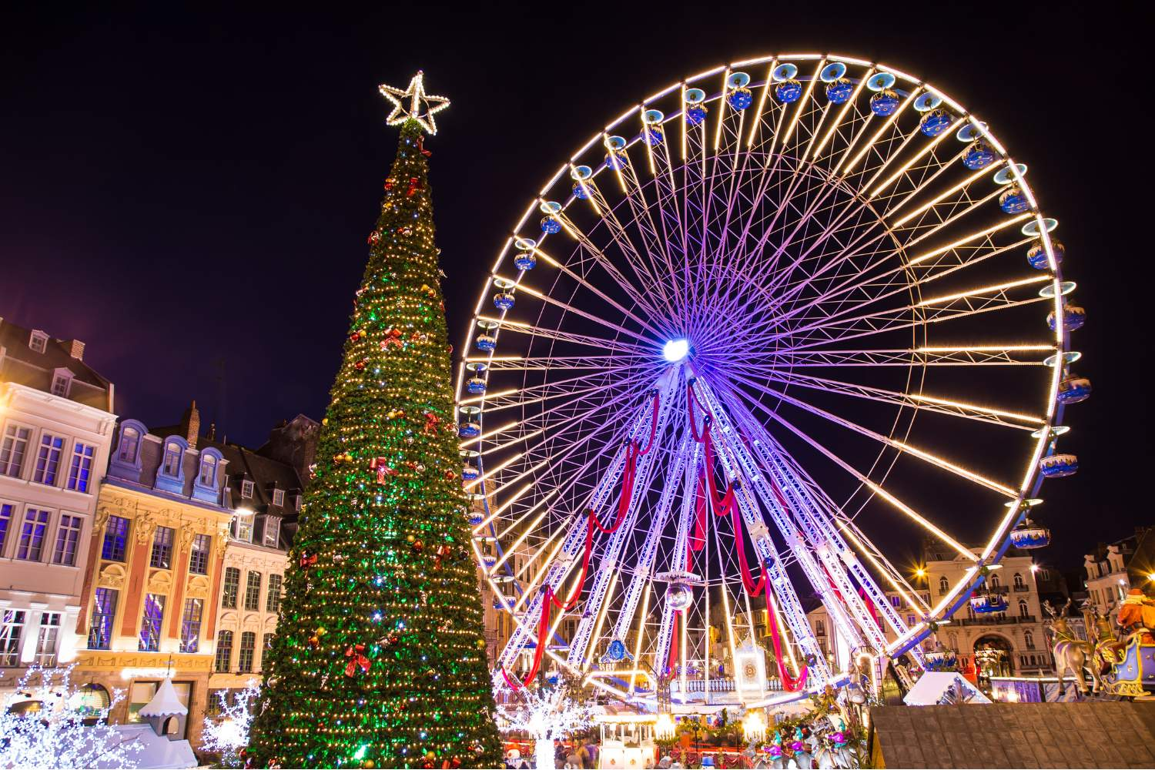
Lille Christmas Market
Lille Christmas market is perfect for a festive day trip.
With over 90 wooden chalets offering artisan gifts, festive decorations, and delicious seasonal treats. Stroll through twinkling lights, soak up the warm holiday atmosphere, and enjoy traditional carols as you browse.
Boulogne Town Trail
Your animateur organises this activity with our tailor made Town Trail requiring the students to read, understand and speak French

Slide 9
Biscuit factory
Step inside a traditional French biscuit factory and discover the secrets behind some of France’s most beloved sweet treats.
Learn about the baking process and enjoy the irresistible aroma of freshly baked goods. Of course, no visit would be complete without a shortbread tasting session.
Boulogne Town Trail
Your animateur organises this activity with our tailor made Town Trail requiring the students to read, understand and speak French

Slide 10
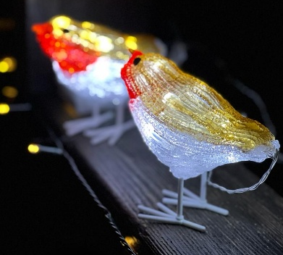
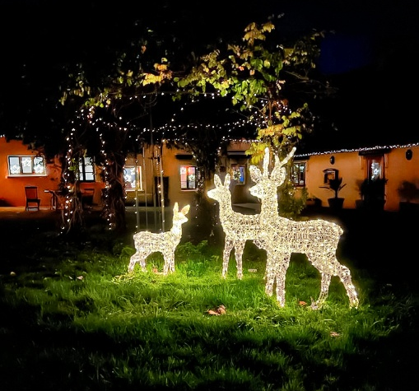
France is waiting for you!
Click here for more information about the trip!
Find us on

