Slide 1
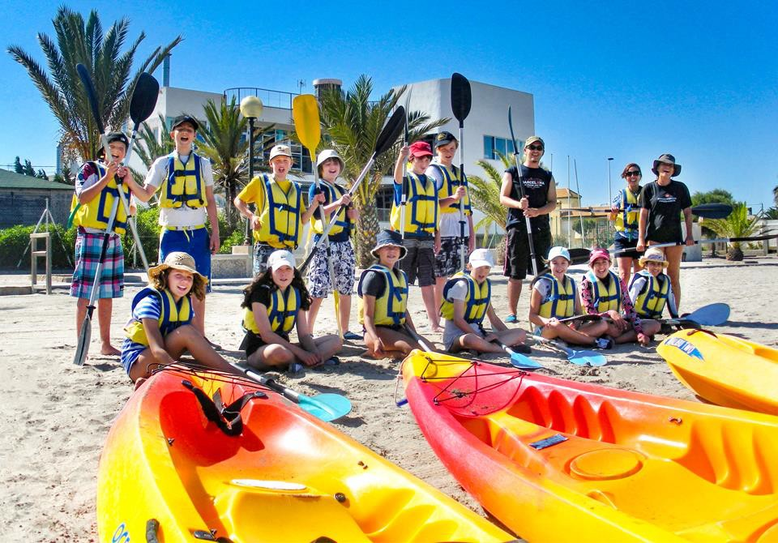
Spain – Arbolar Beach
D-DD-MM-YYYY

Slide 2
We help students reach new heights
Voyager School Travel specialises in educational school trips where students can learn, thrive and achieve their potential outside the classroom.
We believe that every school trip should provide students with new experiences, learning activities and exposure to local culture with genuine educational benefit.
Over 35,000 students travel with us each year

Slide 3
You’re in
safe hands
Your child’s safety is our priority and
we ensure the highest standards are met.
ABTA member
ATOL and ABTOT financial protected
School Travel Forum (STF) member
Learning Outside the Classroom (LOtC) Quality Badge holder
AAIAC Adventuremark holder
Audited safety management system
All accommodation audited
More about accreditation.

Slide 4
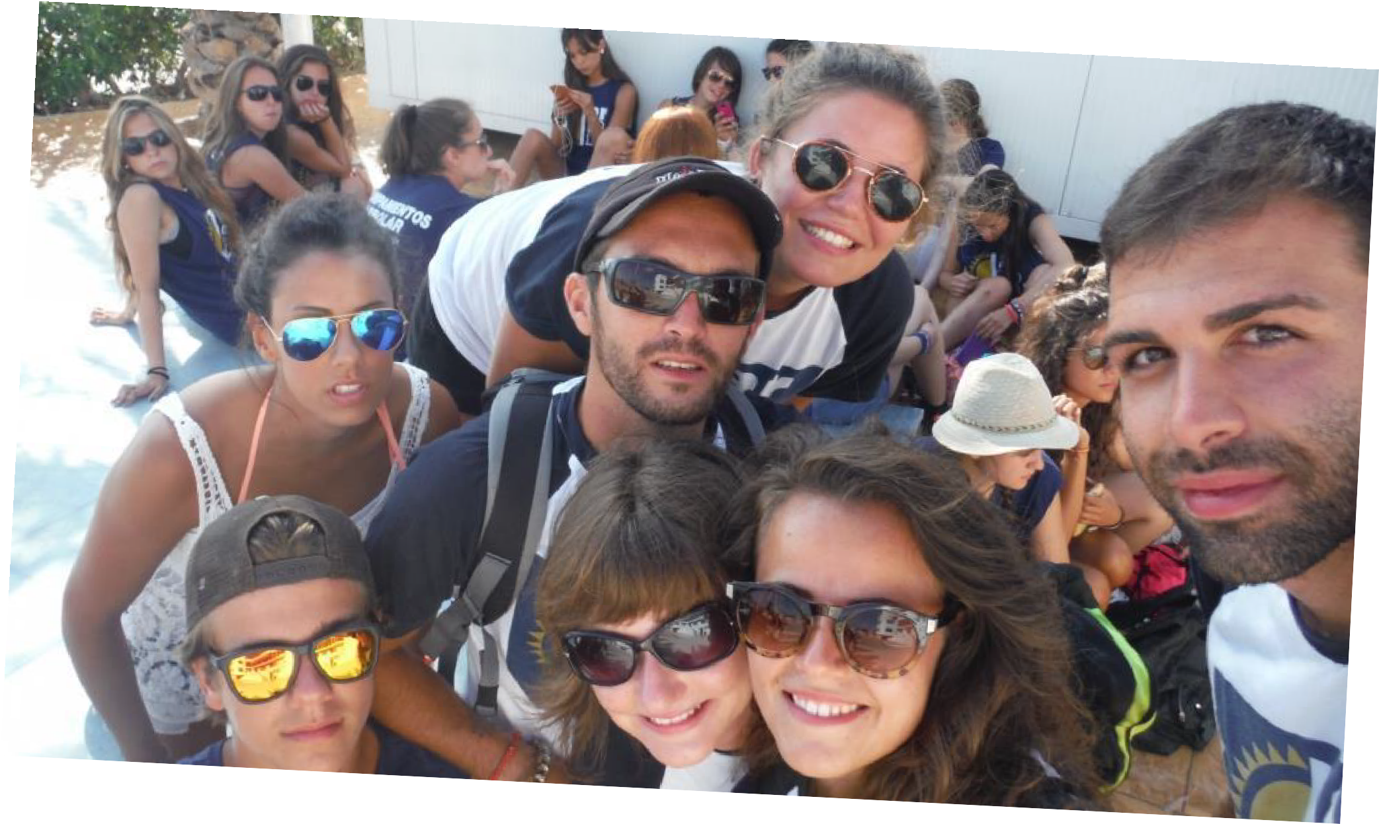
Meet your monitors
Your party will be accompanied by a centre ‘monitor’. Our monitors are native Spanish speaking and they converse in Spanish with your students as well as leading the group throughout the week.

Slide 5
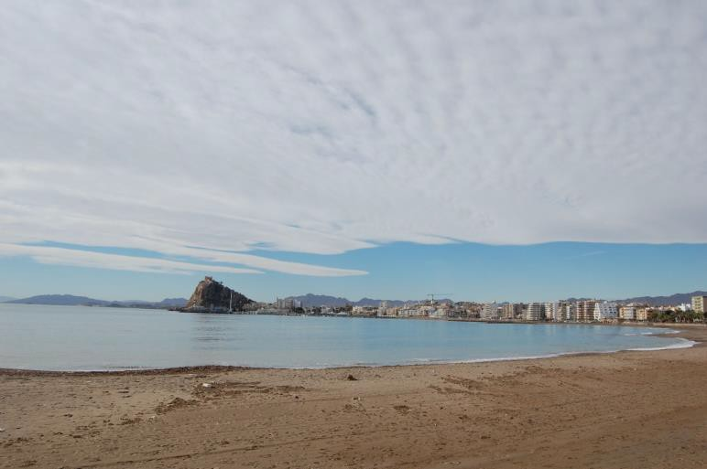
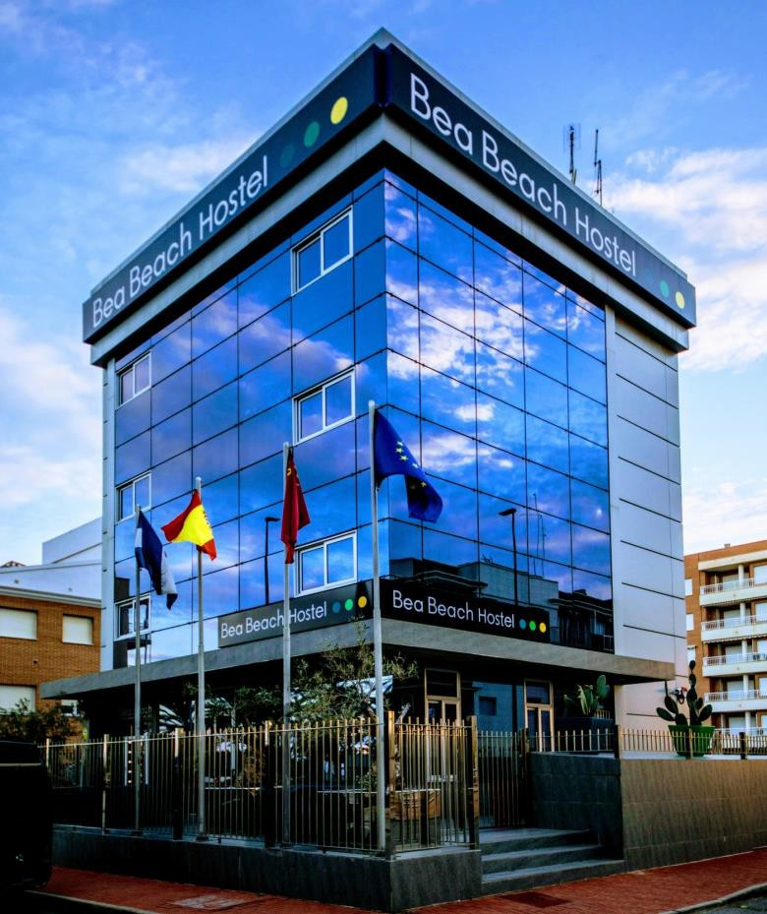
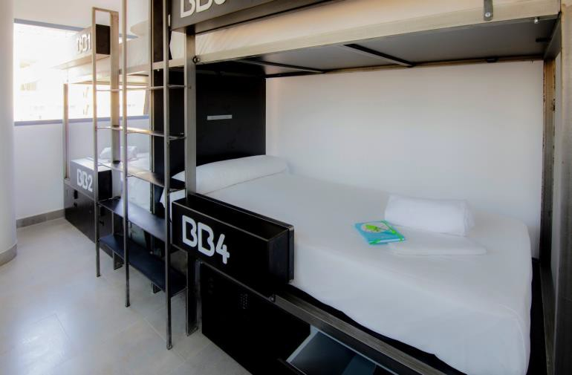
Accommodation
BeaBeach Hostel
Calle Antonio Sánchez Cáceres, 4, 30880 Águilas, Murcia, Spain
Students must bring their own towels

Slide 6
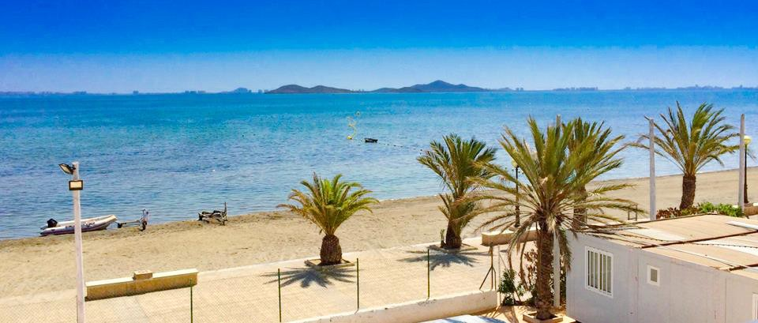
Day 1
Depart UK > Arrive at Alicante airport
Meet your monitor > Coach transfer to Arbolar centre
Orientation > Presentation games
Team beach sports (Football, volleyball, tennis)

Slide 7
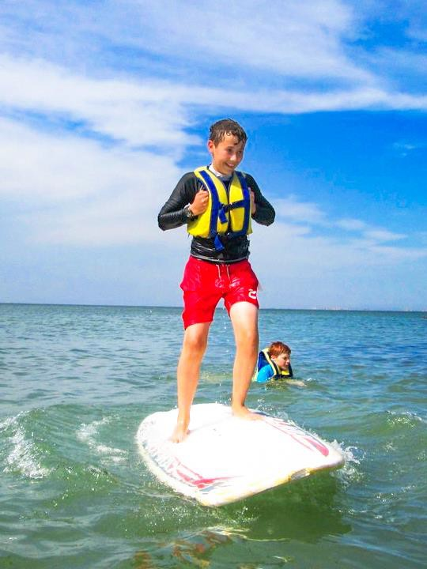
Day 2
Watersports
All taught in Spanish by fully qualified instructors, students learn how to Kayak, Sail and/or Windsurf on the waters of the Mar Menor

Slide 8
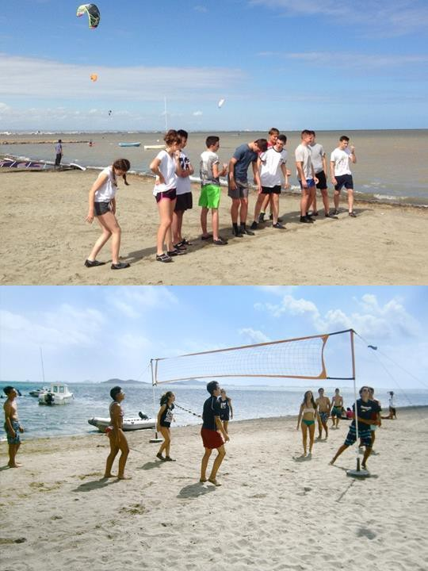
Day 3
Olympic Beach Games
Students play traditional games such as: skipping rope, replay race, balance games, dodgeball all on the coastline of Los Urrutias, all instructed in Spanish

Slide 9
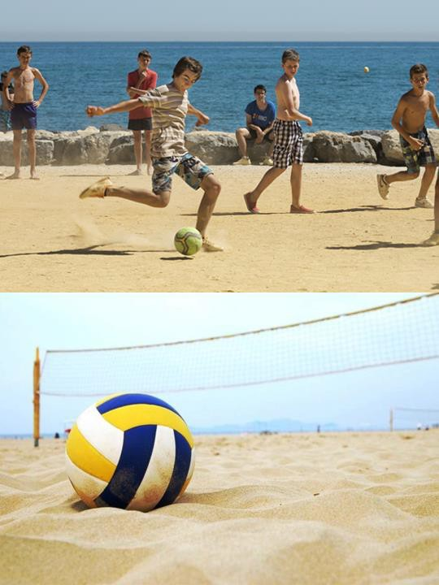
Day 3
Beach Sports
All taught in Spanish you can play beach football, beach-volleyball, beach tennis all in teams

Slide 10
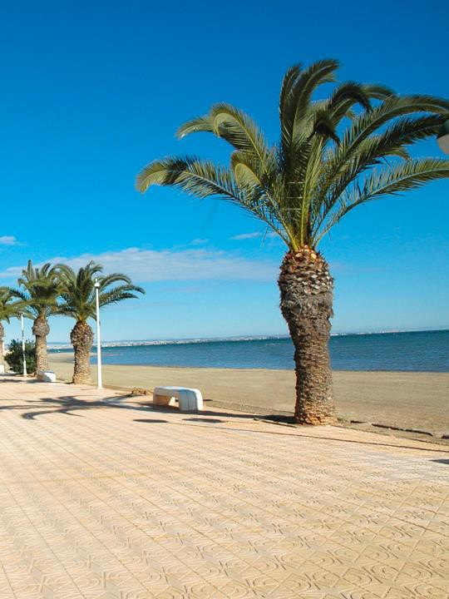
Day 3
Beach Photography Challenge
Your group is divided in subgroups and are tasked with taking photos of different objects and sights on the beach. The student with the best photo is the winner!

Slide 11
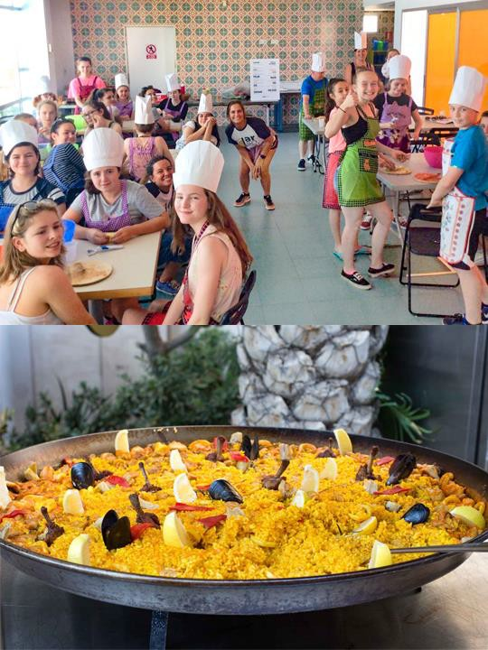
Day 4
Spanish Cooking Workshop
Learn food-specific Spanish vocabulary while you get your hands dirty preparing a traditional Spanish dish

Slide 12
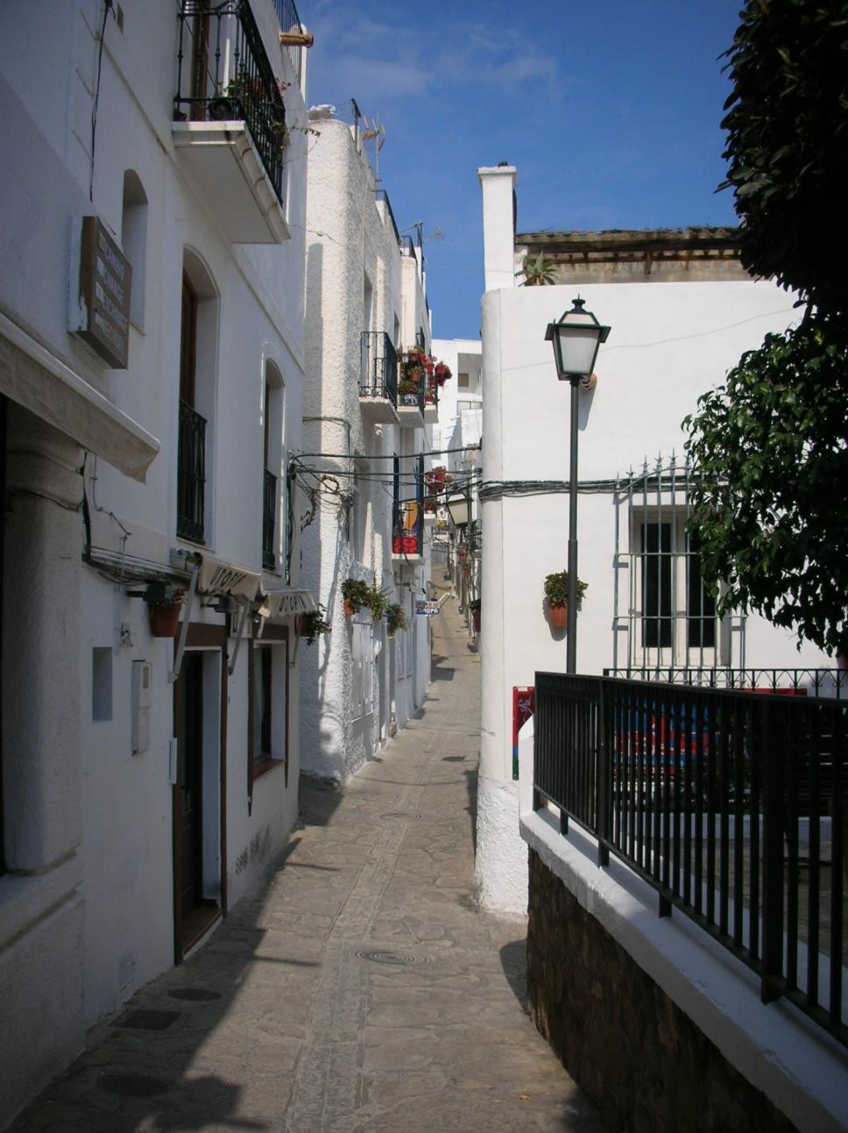
Day 4
Aguilas Town Visit
Board your coach to the town of Aguilas.
Take a tour of the Castle with a visit to shops and the port.
Enjoy a boat trip!
Test your vocabulary with a Spanish quiz.

Slide 13
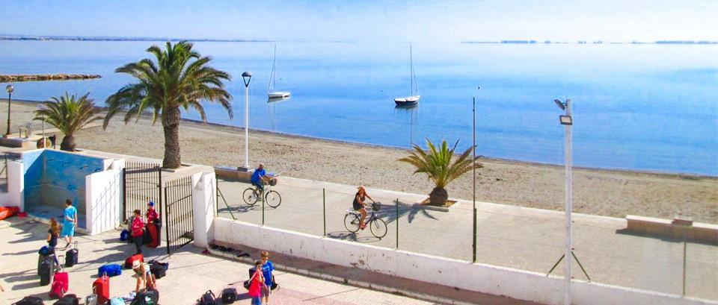
Day 5
Check out > More Spanish activities flight time permitting
Transfer to airport > Arrive back in the UK

Slide 14
Additional notes
Students must make their own way to Gatwick airport
Please keep all valuables in a safe place.
Please ensure you have all of your belongings, valuables from safe, and passports
before departing the hotel.
Some hotels/centres require damage deposits on arrival, Voyager will endeavour to inform groups if such payments are required. We always advise room inspections upon check-in for pre-recorded damage.
Voyager also recommend carrying out a fire drill, or at least ensuring that all pupils are aware of all emergency exits and fire assembly points.
International check in times after 3pm on arrival day and check out by 10 am on last day. We will try to arrange luggage storage rooms in case or earlier arrival or late departure..
If groups are delayed en route to accommodation OR visits we ask that they telephone
the supplier in advance.
Voyager provides an emergency 24 hour care line for teachers whilst out on tour for any questions or queries

Slide 15
Thank you
Click here for more information about the trip!
Find us on

