Slide 1
Our trip to
the Opal Coast of France
School Name Date

Slide 2
We help students reach new heights
Voyager School Travel specialises in educational school trips where students can learn, thrive and achieve their potential outside the classroom.
We believe that every school trip should provide students with new experiences, learning activities and exposure to local culture with genuine educational benefit.
Over 35,000 students travel with us each year

Slide 3
You’re in
safe hands
Your child’s safety is our priority and
we ensure the highest standards are met.
ABTA member
ATOL and ABTOT financial protected
School Travel Forum (STF) member
Learning Outside the Classroom (LOtC) Quality Badge holder
AAIAC Adventuremark holder
Audited safety management system
All accommodation audited
More about accreditation.

Slide 4
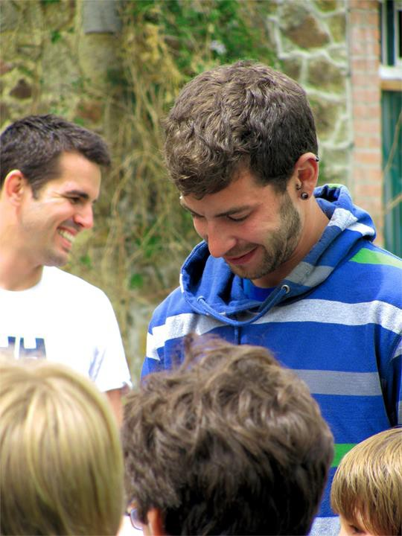
Meet your animateur
Upon your arrival you’ll meet your
animateur!
Our specially trained French native animateurs will be speaking with and encouraging interactive responses from you throughout your stay to challenge you and improve your language skills

Slide 5
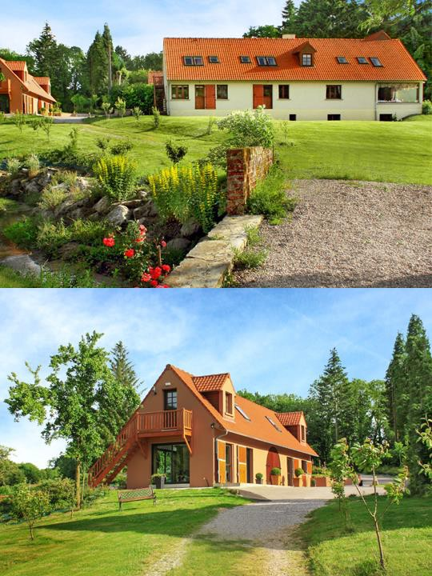
Check in
Check in to the Moulin aux Draps school centre where you will meet your Animateur and get settled
This centre is set in 22 acres of peaceful green fields with plenty of space to wander safely. During term time, it is exclusively for the use of school groups meaning there are few other distractions for students

Slide 6
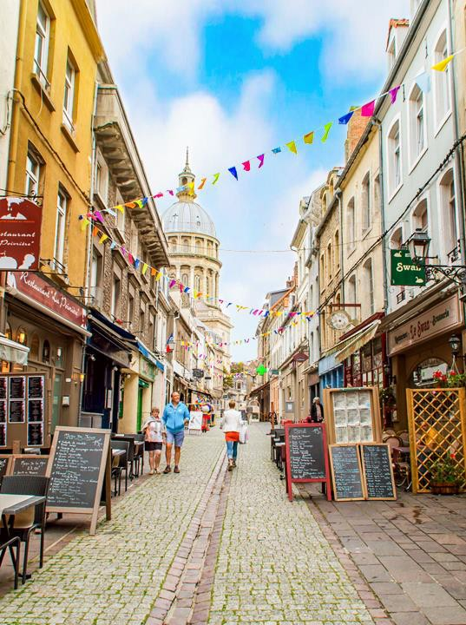
Boulogne town trail
Your animateur organises this activity with our tailor made Town trail requiring the students to read, understand and speak French
The largest fishing port in France, Boulogne has a lively atmosphere including a vibrant market at the heart of the medieval Old Town
Boulogne Town Trail
Your animateur organises this activity with our tailor made Town Trail requiring the students to read, understand and speak French

Slide 7
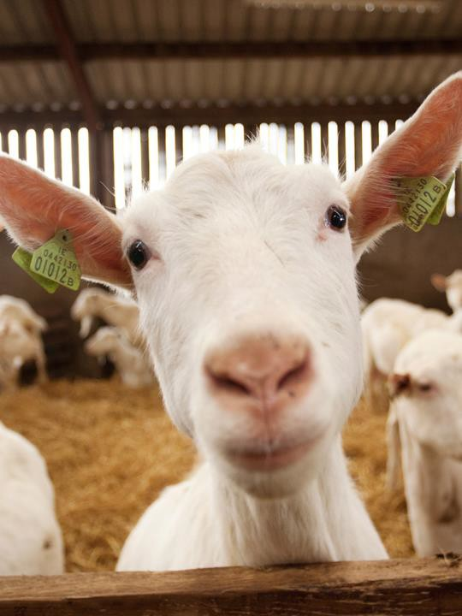
Goat cheese farm
An interactive visit of a local working goat farm and cheese producer (or similar alternative) Includes the all important tasting
Boulogne Town Trail
Your animateur organises this activity with our tailor made Town Trail requiring the students to read, understand and speak French

Slide 8
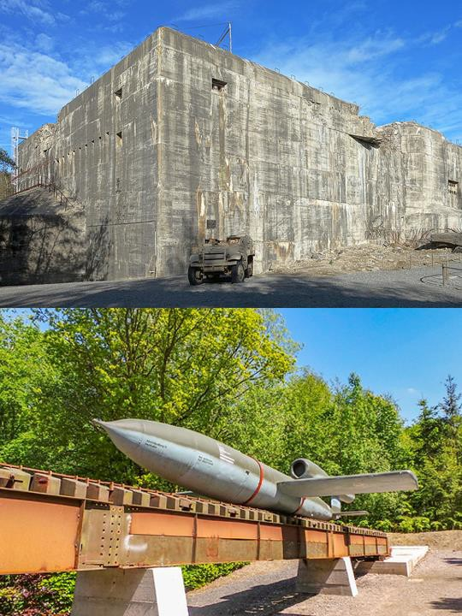
Blockhaus d'Eperlecques
The bunker of Eperlecques is the biggest bunker of the north of France, as a witness of this dark period, from 1939 to 1945. It was opened to the public in 1974 and classified "ancient memorials" in 1985
Boulogne Town Trail
Your animateur organises this activity with our tailor made Town Trail requiring the students to read, understand and speak French

Slide 9
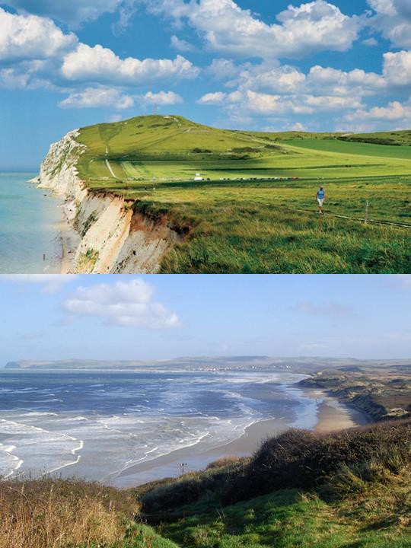
Les
Deux Caps
These two headlands offer spectacular views across the channel and up and down the Opal Coast. On clear days The White Cliffs of Dover seem no distance away at all
It is possible to walk along the coastal paths from the car-parks located at both headlands, and observe the birdlife as well as the former defensive buildings from WW2
Boulogne Town Trail
Your animateur organises this activity with our tailor made Town Trail requiring the students to read, understand and speak French

Slide 10
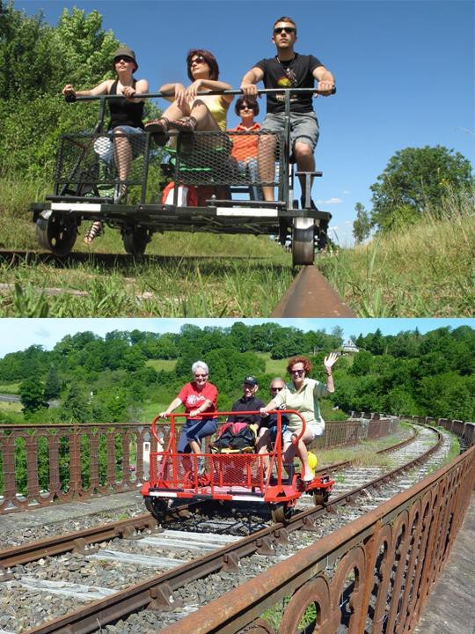
Rando Rail
Is it a bike or a go-kart? It is something between the two. Each vehicle takes 4 people at a time as you pedal along the 10 km scenic disused railway track reaching quite a speed when you free wheel down to the bottom at the end
A lovely way to enjoy the countryside and suitable for all ages. There is even a special hammock for dogs
Boulogne Town Trail
Your animateur organises this activity with our tailor made Town Trail requiring the students to read, understand and speak French

Slide 11
Chocolate factory
Take a trip to Les Chocolats de Beussent to see how the world’s most popular food is made
You will have the opportunity to experience a guided English or French tour of the workshop, and see the process of melting, moulding and coating, you will even be offered the chance to taste some for yourself
Boulogne Town Trail
Your animateur organises this activity with our tailor made Town Trail requiring the students to read, understand and speak French

Slide 12
Local bakery
Visit a local French bakery or “Boulangerie” for a demonstration in French
You will walk away with a croissant
and a pain au chocolat each
Boulogne Town Trail
Your animateur organises this activity with our tailor made Town Trail requiring the students to read, understand and speak French

Slide 13
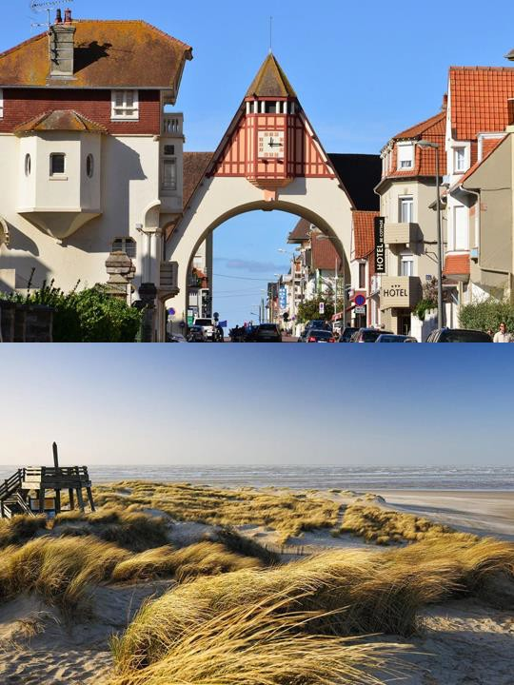
Le Touquet
Visit the seaside town of Le Touquet with miles of stunning white sand beach to explore the morning market
Boulogne Town Trail
Your animateur organises this activity with our tailor made Town Trail requiring the students to read, understand and speak French

Slide 14
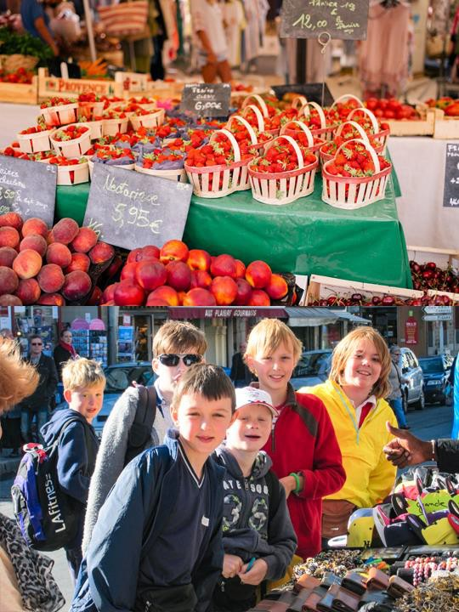
Market Mission
Visit a local market with your animateur. Teams of students will be given money to buy ingredients for a packed lunch and you will also have some general shopping time
Return to your accommodation where your animateur will organise a competition for the best lunch
Boulogne Town Trail
Your animateur organises this activity with our tailor made Town Trail requiring the students to read, understand and speak French

Slide 15
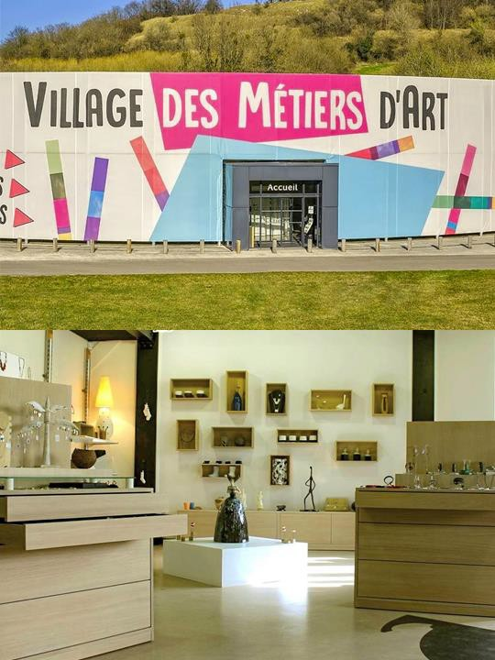
Desvres Art Centre
Enjoy a guided tour and workshop in one of the creative techniques offered by these two local craft centres
The area is rich in the raw materials needed for pottery resulting in a thriving local industry
Boulogne Town Trail
Your animateur organises this activity with our tailor made Town Trail requiring the students to read, understand and speak French

Slide 16
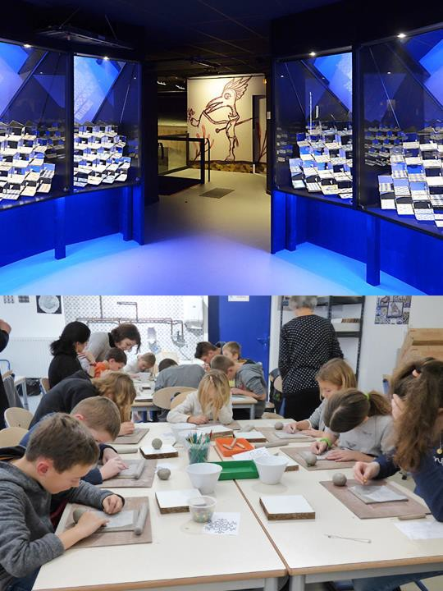
Museum of Ceramics
Enjoy a guided tour and workshop in one of the creative techniques offered by these two local craft centres
The area is rich in the raw materials needed for pottery resulting in a thriving local industry
Boulogne Town Trail
Your animateur organises this activity with our tailor made Town Trail requiring the students to read, understand and speak French

Slide 17
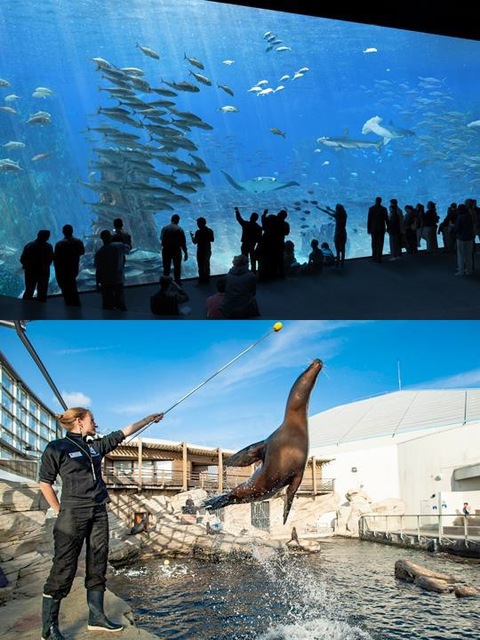
Nausicaa
One of France’s most popular attractions, this world class aquarium is a highlight of the region
With good eco credentials, Nausicaa is home to a wide range of exhibits including a stunning living reef, sea- lion pool and tropical lagoon with sharks
Boulogne Town Trail
Your animateur organises this activity with our tailor made Town Trail requiring the students to read, understand and speak French

Slide 18
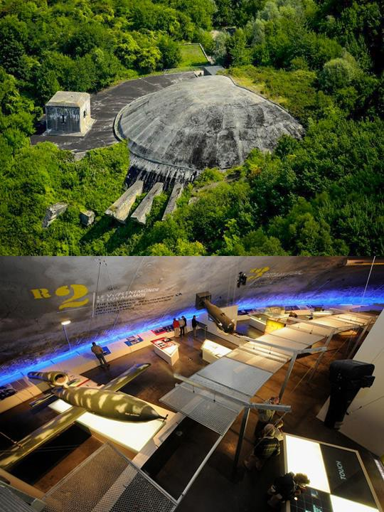
La Coupole
The dome was built in 1944 to
house jet propelled explosive rockets destined to fire into Britain
The gigantic bunker is now an exceptional historical museum and an interactive planetarium!
Boulogne Town Trail
Your animateur organises this activity with our tailor made Town Trail requiring the students to read, understand and speak French

Slide 19
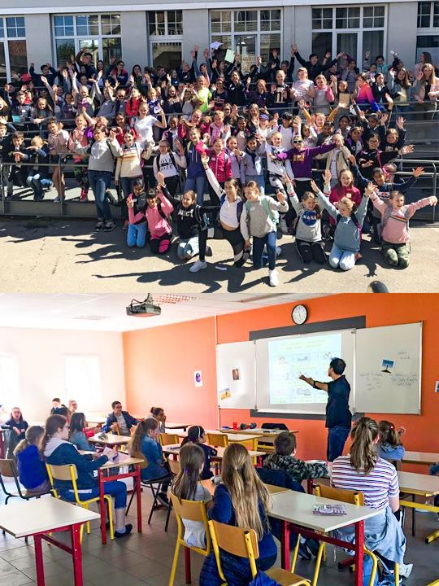
French school visit
Spend the morning with your French partner school and meet French students of the same age
A great chance to practise your
French speaking skills!
Boulogne Town Trail
Your animateur organises this activity with our tailor made Town Trail requiring the students to read, understand and speak French

Slide 20
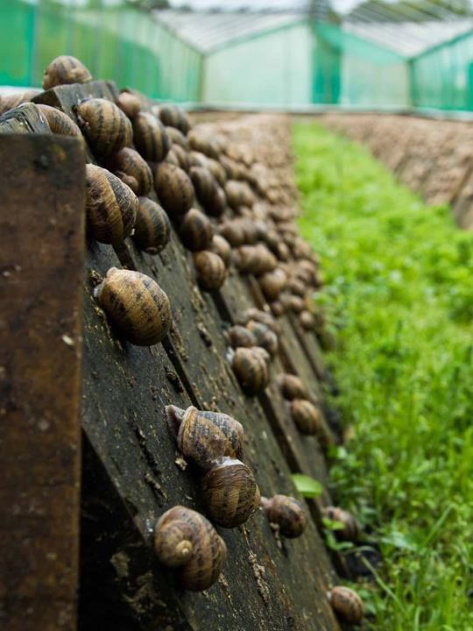
Snail farm
An informative and entertaining introduction to the cultivation of snails
This visit is always a hit with students and they even get to taste some of the products
Boulogne Town Trail
Your animateur organises this activity with our tailor made Town Trail requiring the students to read, understand and speak French

Slide 21
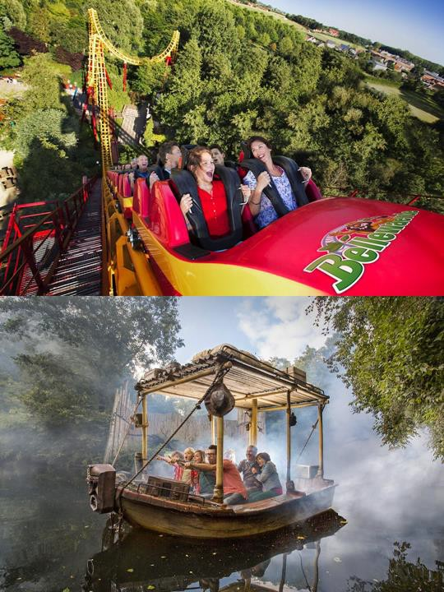
Bellewaerde
Boasting among other things the highest water chute in Europe, Bellewaerde Park is just across the border in Belgium
Enjoy thrilling rides, marvel at exotic animals and explore the park
Boulogne Town Trail
Your animateur organises this activity with our tailor made Town Trail requiring the students to read, understand and speak French

Slide 22
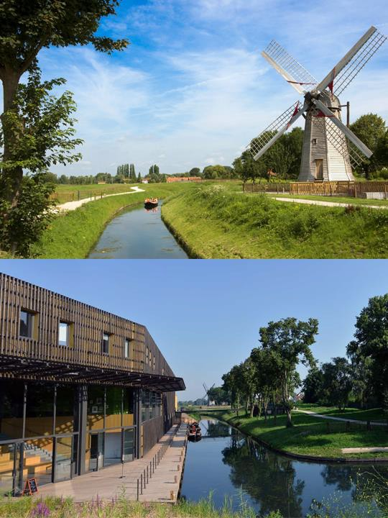
Maison du Marais
Discover the Audomarois marshland. The exhibitions include models and artefacts, films and aquariums
When you’ve discovered the background to the marshland, glide through the waterways in a flat- bottomed boat with an expert guide to see the island homes of the residents, the flora and fauna
Boulogne Town Trail
Your animateur organises this activity with our tailor made Town Trail requiring the students to read, understand and speak French

Slide 23
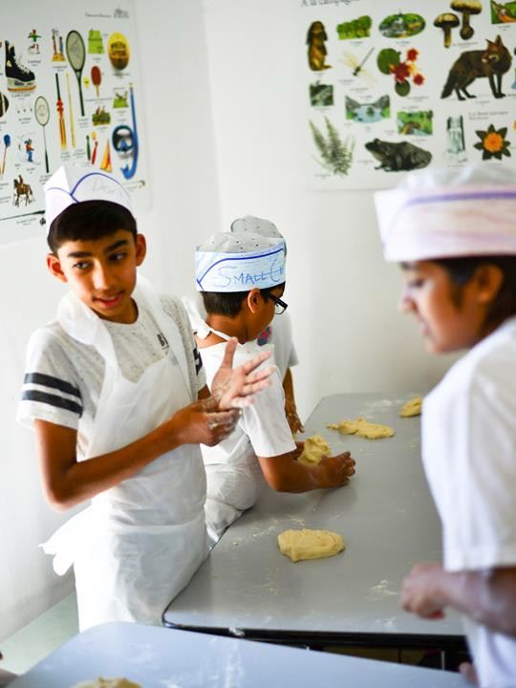
Bread making
Enjoy a morning of bread making on site with your animateur - your group will learn the art of bread production and can enjoy their creations!
Boulogne Town Trail
Your animateur organises this activity with our tailor made Town Trail requiring the students to read, understand and speak French

Slide 24
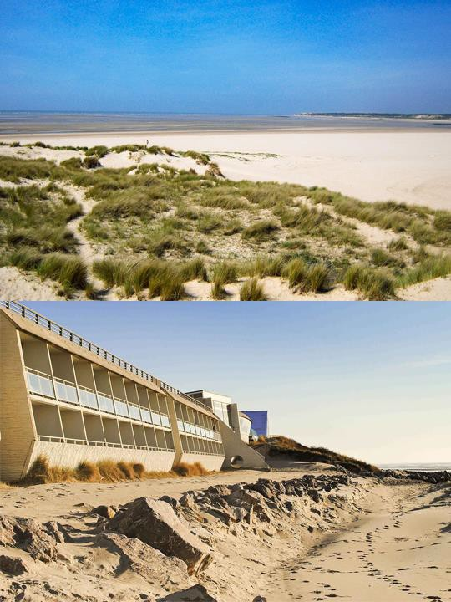
Beach games
The Opal Coast is characterised by gorgeous white sandy beaches which become a playground for all sorts of beach games at low tide
Your animateur has all the equipment needed for this activity
Boulogne Town Trail
Your animateur organises this activity with our tailor made Town Trail requiring the students to read, understand and speak French

Slide 25
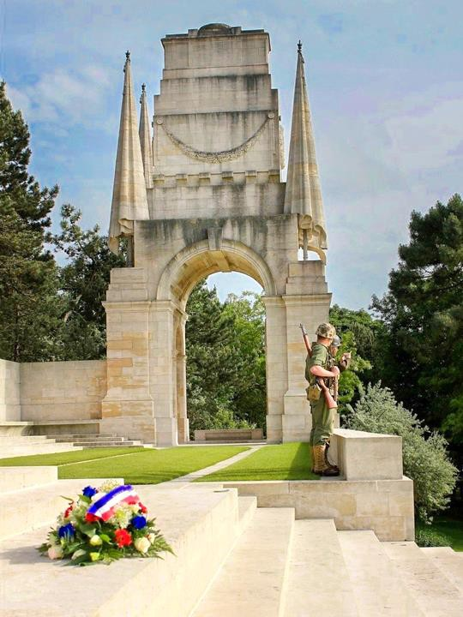
Étaples Military Cemetery
Étaples Military Cemetery is a Commonwealth War Graves Commission cemetery in Étaples, near Boulogne on the north-west coast of France
The cemetery commemorates over 11,500 lives lost in WWI and WWII
Boulogne Town Trail
Your animateur organises this activity with our tailor made Town Trail requiring the students to read, understand and speak French

Slide 26
France is waiting for you!
Click here for more information about the trip!
Find us on

