Slide 1
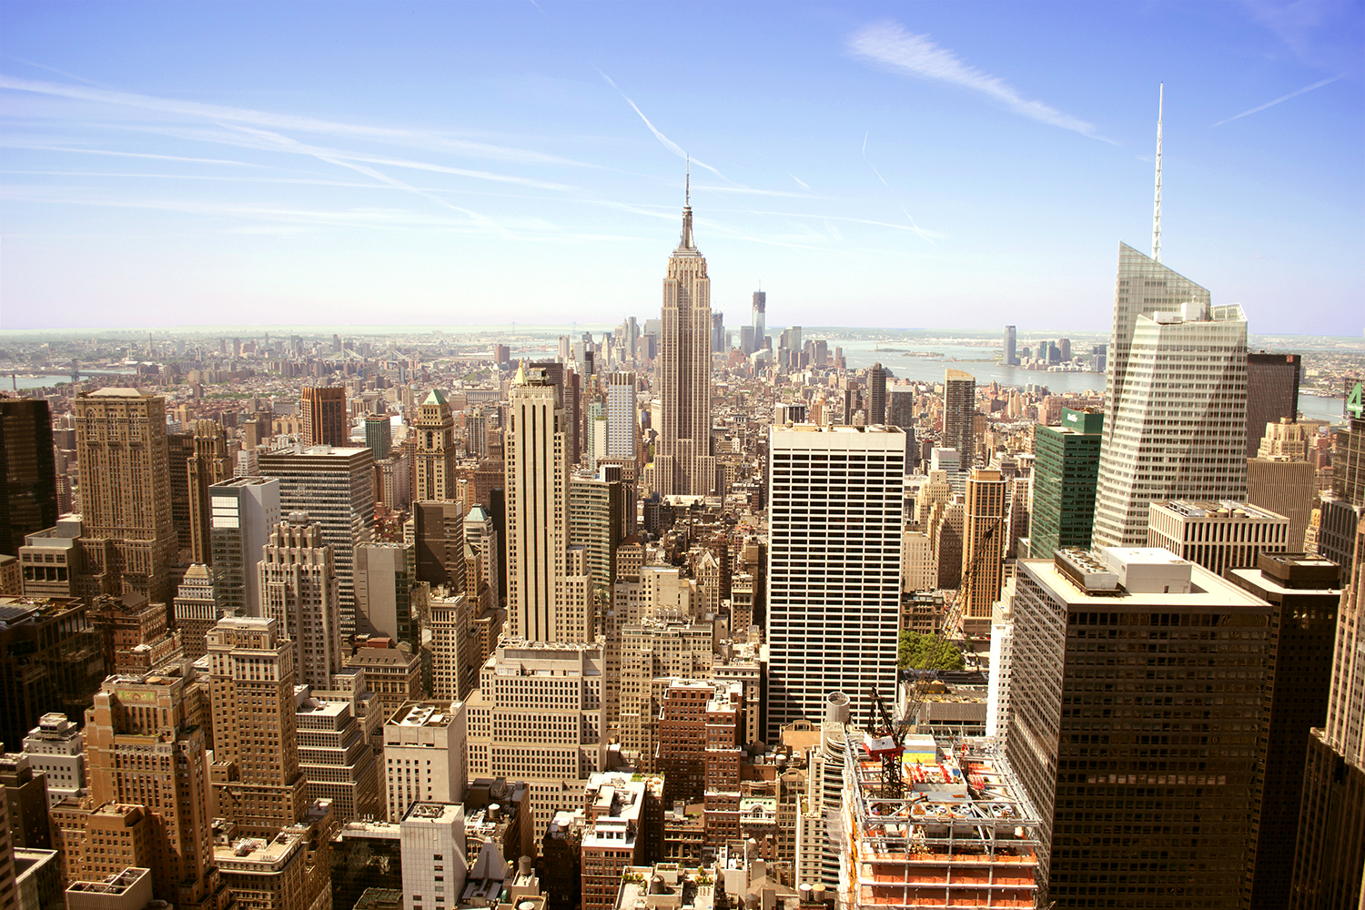
Your trip to New York
School Name
DD–DD MM YYYY

Slide 2
We help students reach new heights
Voyager School Travel specialises in educational school trips where students can learn, thrive and achieve their potential outside the classroom.
We believe that every school trip should provide students with new experiences, learning activities and exposure to local culture with genuine educational benefit.
Over 35,000 students travel with us each year

Slide 3
You’re in
safe hands
Your child’s safety is our priority and
we ensure the highest standards are met.
ABTA member
ATOL and ABTOT financial protected
School Travel Forum (STF) member
Learning Outside the Classroom (LOtC) Quality Badge holder
AAIAC Adventuremark holder
Audited safety management system
All accommodation audited
More about accreditation.

Slide 4
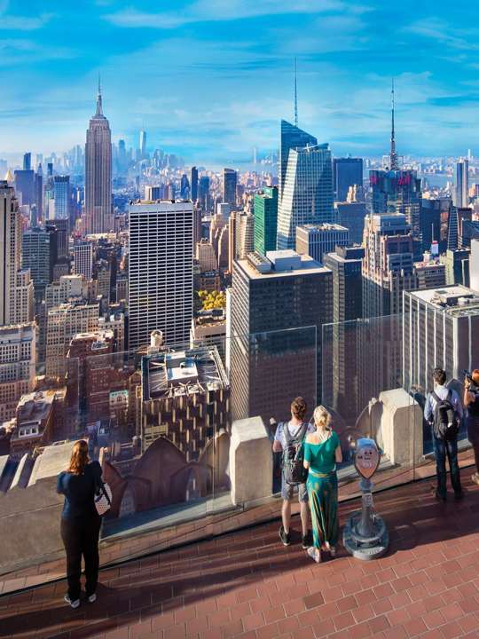
Top of the Rock
Visit the Top of the Rock observation deck atop the Rockefeller Centre for the quintessential view of New York City!
Gaze at Central Park, the Empire State Building, the Chrysler Building, the World Trade Centre and even the Statue of Liberty in the far distance.
Boulogne Town Trail
Your animateur organises this activity with our tailor made Town Trail requiring the students to read, understand and speak French

Slide 5
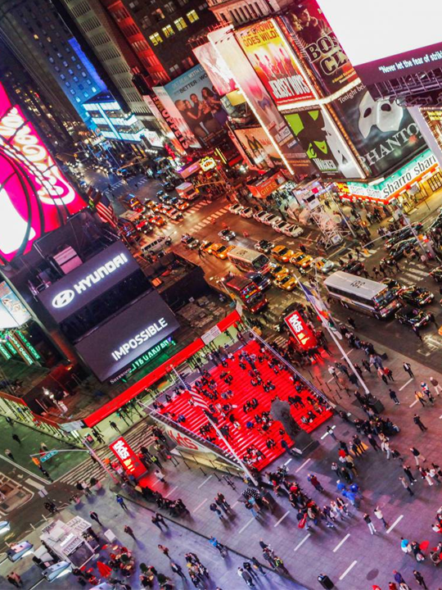
Times Square
Take some time to explore the world-famous major commercial intersection and hub of activity in Midtown Manhattan. With its giant lit up screens, shops and restaurants.
Boulogne Town Trail
Your animateur organises this activity with our tailor made Town Trail requiring the students to read, understand and speak French

Slide 6
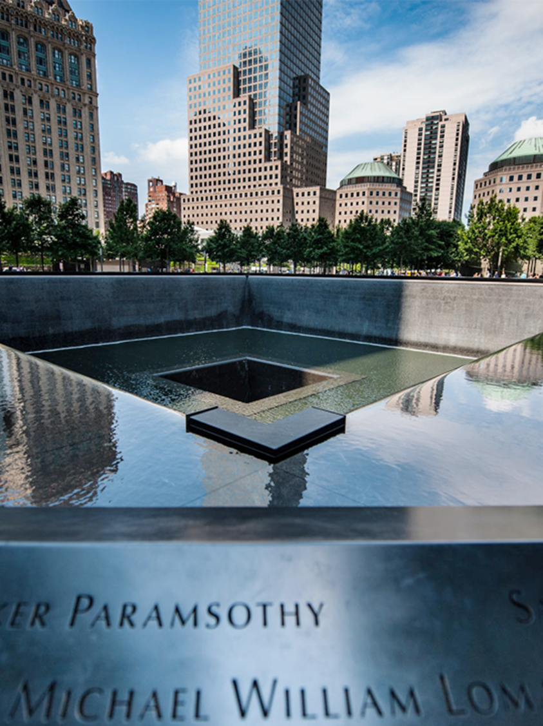
National September 11 Memorial
Boulogne Town Trail
Your animateur organises this activity with our tailor made Town Trail requiring the students to read, understand and speak French
Visit the moving national tribute of remembrance and honour to the nearly 3000 men and women who lost their lives in the 9/11 terror attacks which resulted in the collapse of the twin towers.
Infinity pools now stand in their massive footprint

Slide 7
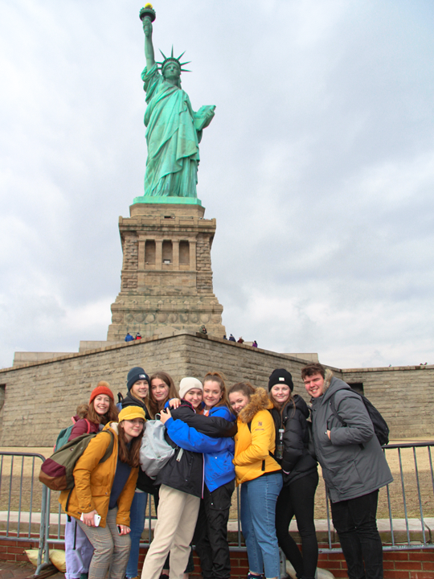
Statue of Liberty & Ellis Island tour
Boulogne Town Trail
Your animateur organises this activity with our tailor made Town Trail requiring the students to read, understand and speak French
Take a short ferry ride from Manhattan and visit one of New York's most iconic sites - the Statue of Liberty, located on historic Ellis Island and home to the Immigration Museum.

Slide 8
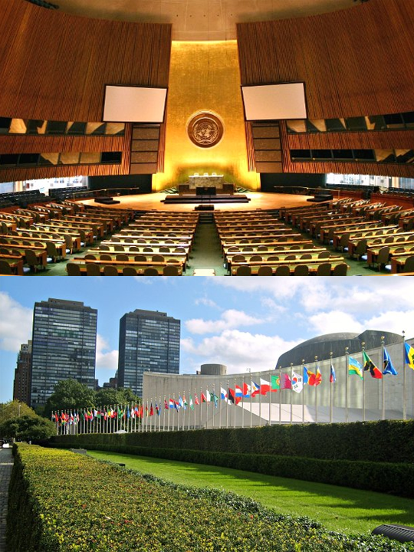
United Nations Tour
Visit the UN headquarters for a tour to get a behind-the-scenes view of the organisation at work.
Boulogne Town Trail
Your animateur organises this activity with our tailor made Town Trail requiring the students to read, understand and speak French

Slide 9
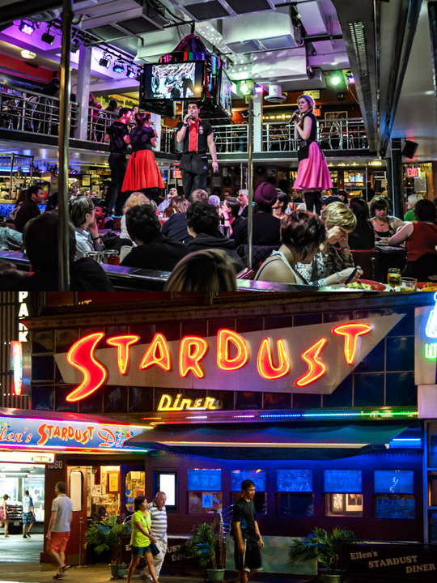
Ellen’s Stardust Diner
The home of the world famous singing waitresses and waiters and some of the best diner food in the country. Serving Breakfast, Lunch and Dinner for tour groups and locals alike since 1987!
Boulogne Town Trail
Your animateur organises this activity with our tailor made Town Trail requiring the students to read, understand and speak French

Slide 10
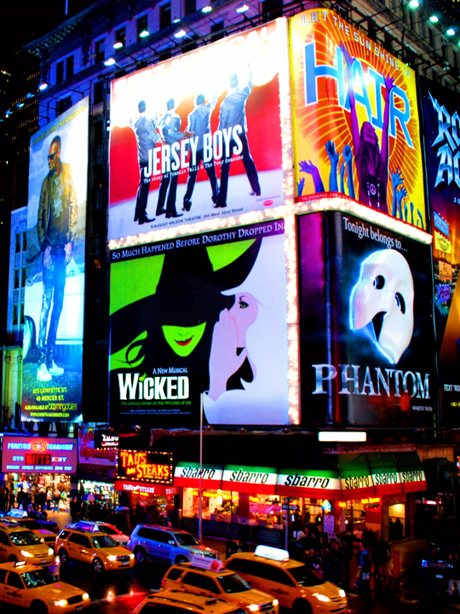
Broadway Show
The street and district famed for theatre, musicals and glamour, Broadway is the heart of performance in New York.
This is your opportunity to experience a live show!
Boulogne Town Trail
Your animateur organises this activity with our tailor made Town Trail requiring the students to read, understand and speak French

Slide 11
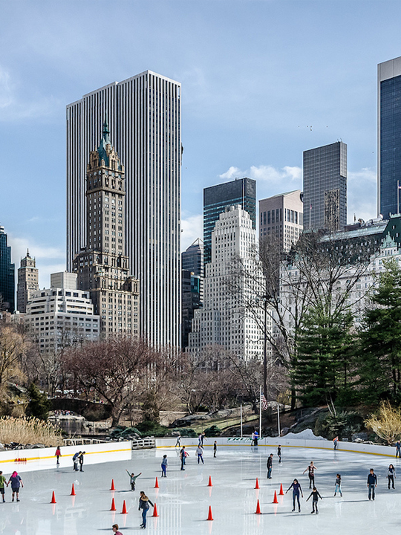
Wollman Ice Rink
Take to the ice and skate on the Wollman Ice Rink in the beautiful setting of Central Park.
Boulogne Town Trail
Your animateur organises this activity with our tailor made Town Trail requiring the students to read, understand and speak French

Slide 12
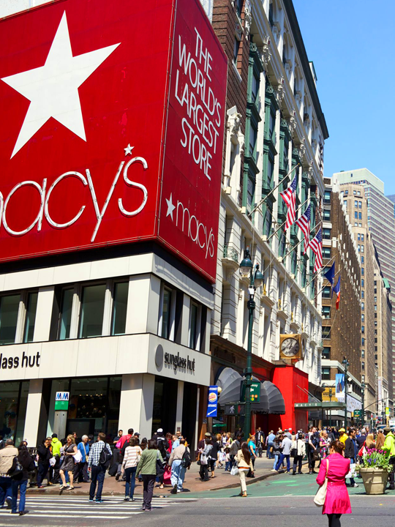
Macy’s Guided Tour
Sitting on Broadway between 34th and 35th streets, Macy's flagship store is a spot for tourists and residents alike. Covering an entire city block, the massive New York landmark is a must-see NYC attraction. You’ll have free time for shopping.
Boulogne Town Trail
Your animateur organises this activity with our tailor made Town Trail requiring the students to read, understand and speak French

Slide 13
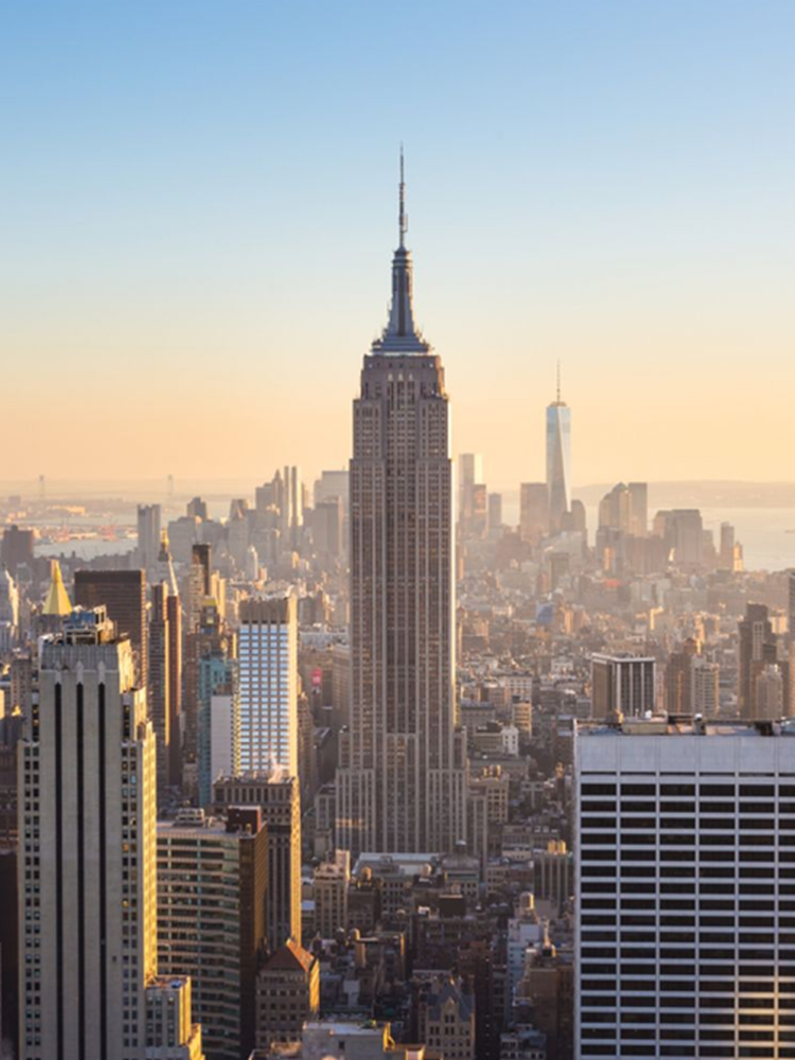
Empire State Building
Travel 102 stories up the Art Deco skyscraper. Learn the history of the building from its construction through to its place in modern-day New York.
Scatter to the observation decks on the 86th and 102nd floors for stunning panoramic views of the city below.
Boulogne Town Trail
Your animateur organises this activity with our tailor made Town Trail requiring the students to read, understand and speak French

Slide 14
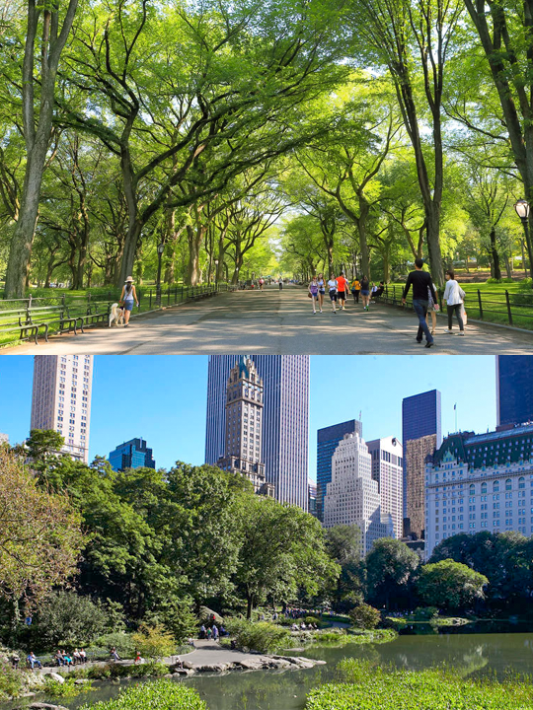
Central Park
Explore Manhattan’s largest urban park, which is nearly 6 times the size of Monaco and has been featured in over 350 films through the years.
Boulogne Town Trail
Your animateur organises this activity with our tailor made Town Trail requiring the students to read, understand and speak French

Slide 15
New York is waiting for you!
Click here for more information about the trip!
Find us on

