Slide 1
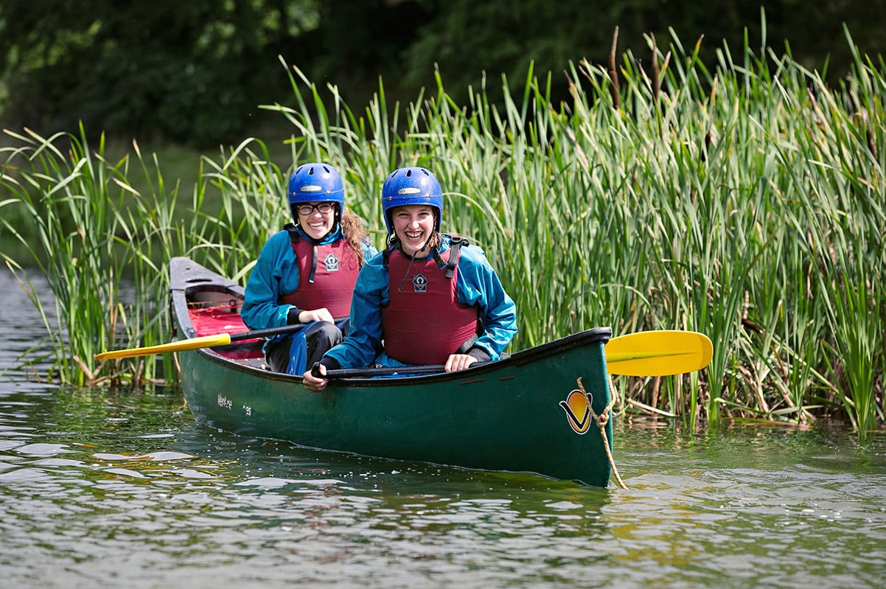
Your trip to Dearne Valley
School Name
DD–DD MM 2022

Slide 2
We help students reach new heights
Voyager School Travel specialises in educational school trips where students can learn, thrive and achieve their potential outside the classroom.
We believe that every school trip should provide students with new experiences, learning activities and exposure to local culture with genuine educational benefit.
Over 35,000 students travel with us each year

Slide 3
You’re in safe hands
Your child’s safety is our priority and we ensure the highest standards are met.
ABTA bonded
School Travel Forum (STF) member
Learning Outside the Classroom (LOtC) Quality Badge holder
AAIAC Adventuremark holder
Audited safety management system
All accommodation audited

Slide 4
Bienvenue à Dearne Valley !
The eco-centric Dearne Valley centre sits on the River Don and boasts fantastic indoor and outdoor activity facilities, purpose-built water sports lake and one of Europe’s largest solar panels!
Students stay in modern, en-suite rooms. Teachers are situated nearby in en-suite rooms with contemporary furnishings, tea and coffee making facilities and a radio-alarm for those early starts.

Slide 5
Your own little slice of France
Experience our tried and tested French language immersion programme in the UK, at the stunning Dearne Valley eco-centre
For a limited time only, learners can enjoy the full French language immersion experience that students and teachers love at our centres in France, without the need to travel overseas
Our native French speaking animateurs will guide your students from the moment they arrive through tasks and activities designed to promote French speaking and listening in a range of real-life scenarios

Slide 6
Meet your animateurs
Hopping over from France especially, our team of native French animateurs will make your time in Dearne Valley an immersive, authentic French experience!
They’ll lead all the fun-filled activities, mealtimes and evening entertainment entirely in French
Every moment is used as an opportunity to get you thinking and speaking in French

Slide 7
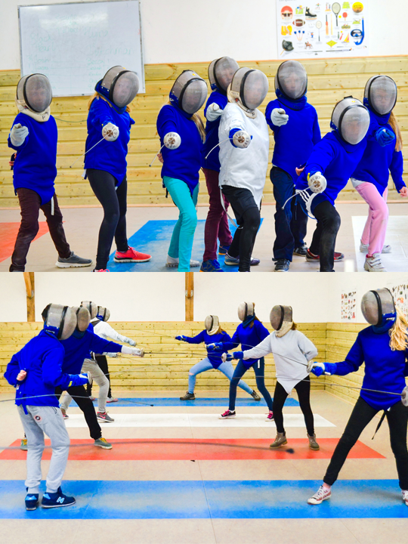
Fencing
En garde !
Did you know that fencing, which is typically associated with French culture, actually has Italian roots?
Gear up in your full kit and try your hand at this fun competitive game and learn some French vocabulary too

Slide 8
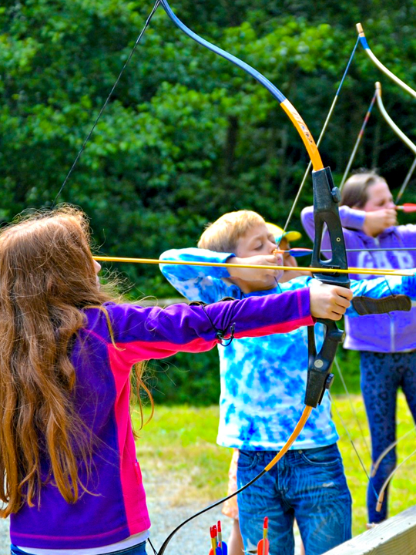
Archery
How’s your aim?
Battle it out against your peers supervised by your French animateurs

Slide 9
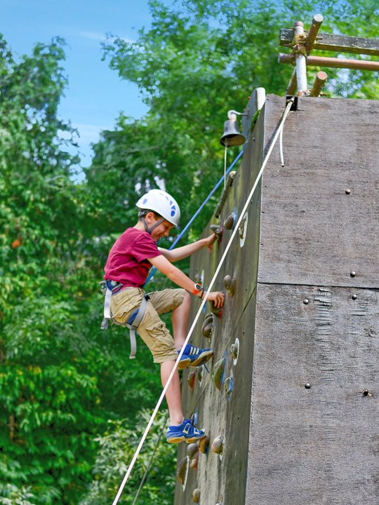
Climbing
Climbing sessions take place at the centre's own climbing wall which is suitable for students of any age
After issuing equipment and explaining the safety procedures, the students will climb various paths on the wall
They will use commands in French to each other and will learn French words for movements and parts of the body

Slide 10
Kayaking
Kayaking sessions are conducted on the beautiful on-site lake
Simple instructions are given in French and the students will master various skills in a very safe and fun environment

Slide 11
Aeroball
Aeroball is your favourite sport you’ve never heard of…
The trampoline-basketball-volleyball game is played in teams of 2
The game is a great opportunity to practise those pesky French numbers as students keep score

Slide 12
Find us on

